Slide 1


Computational Intelligence (TC2023)

Slide 2
Unit V – Web System Protection (1)
Outline
What is required to protect a consumer Web?
Types of Abuse - Authentication and Account Takeover (1/2)

Slide 3

What is required to protect a consumer Web?

Slide 4
What is consumer web?
consumer web: any service accessible over the public internet that provides a product to individual consumers; the service can be free or fee-based.
consumer web attack surfaces:
account access, payment interfaces, and content generation.
Social networks provide another dimension of vulnerability, as attackers can take advantage of the social graph to achieve their goals.

Slide 5
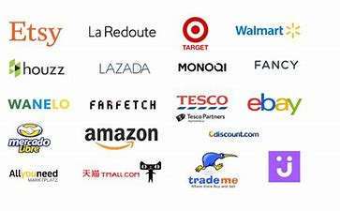
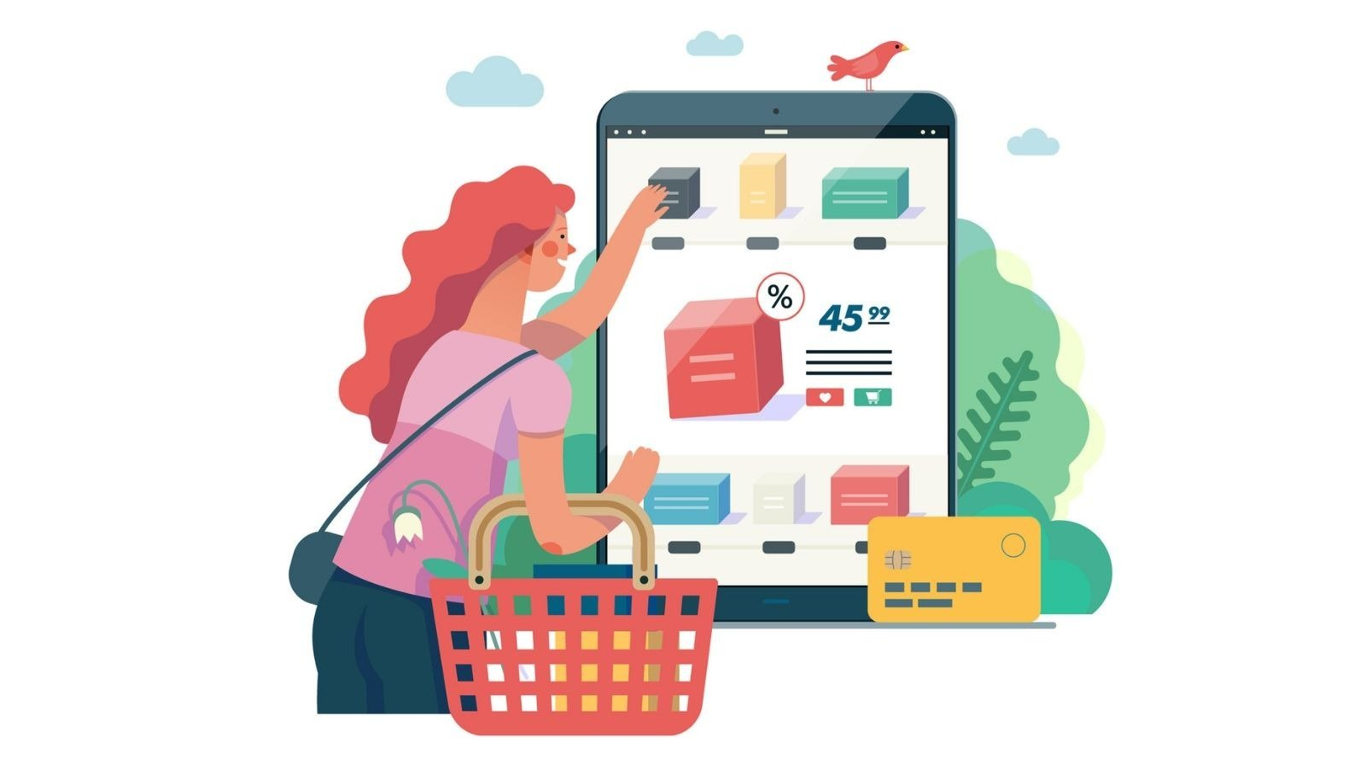
How a hacker directly monetized through attacking web consumer applications?

Slide 6
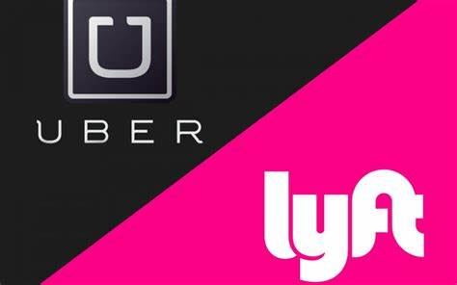

How a hacker directly monetized through attacking web consumer applications?

Slide 7
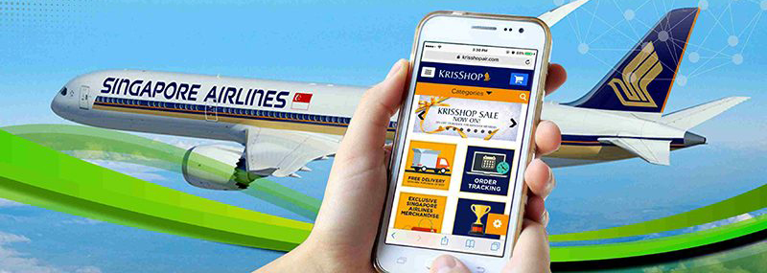
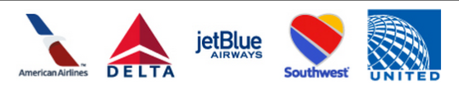
How a hacker directly monetized through attacking web consumer applications?

Slide 8
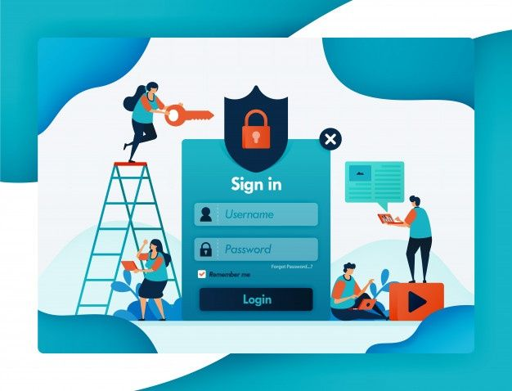
How a hacker directly monetized through attacking web consumer applications?
Protecting accounts on such a service is thus paramount for the site’s continued existence.

Slide 9
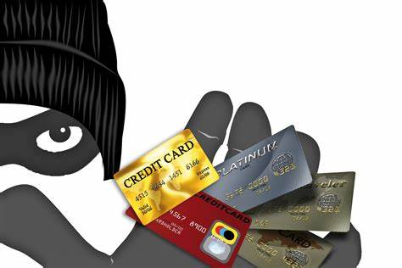
How a hacker directly monetized through attacking web consumer applications?
Fraud is another key concern for many consumer-facing websites.

Slide 10
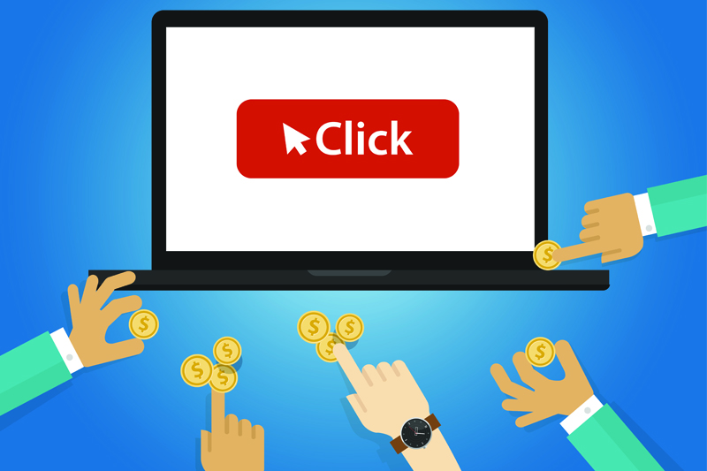
How a hacker directly monetized through attacking web consumer applications?
Click fraud consists of bots or other automated tools clicking links for the sole purpose of increasing click counts.

Slide 11
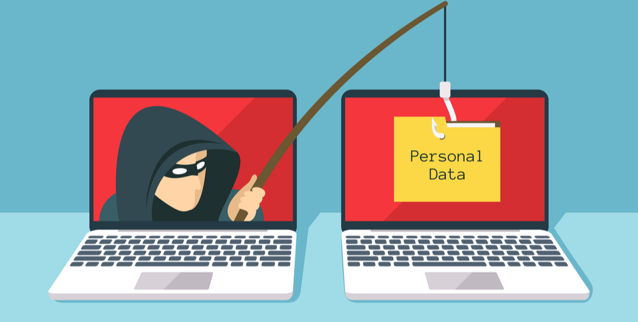

How a hacker indirectly monetized through attacking web consumer applications?
Phishing

Slide 12
Types of Abuse - Authentication and Account Takeover

Slide 13
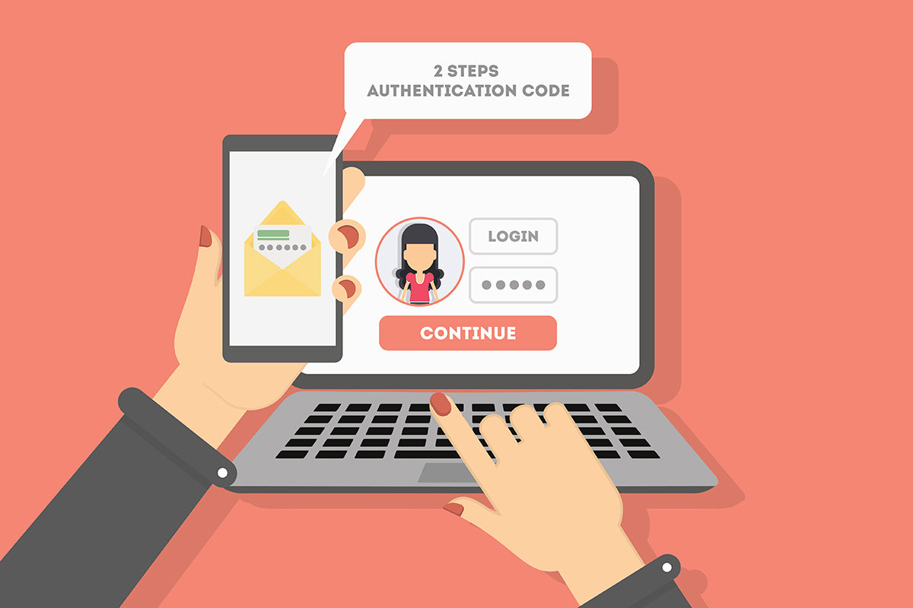
Authentication and Account Takeover
Authentication on the internet today overwhelmingly takes the form of passwords.
In the ideal situation, passwords serve to identify a user by verifying a snippet of information that is known only to that user.

Slide 14
Password Flaws
Users choose passwords that are easy to remember but also easy to guess.
Because it is nearly impossible to remember a unique, secure password for each site, people reuse passwords across multiple sites.
Users are vulnerable to “phishing” campaigns, in which a malicious email or website takes on the appearance of a legitimate login form, and tricks users into revealing their credentials.
Users might write down passwords where they can be easily read or share them with friends, family, or colleagues.

Slide 15
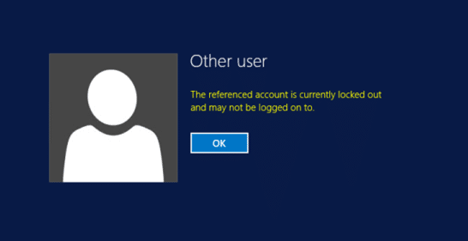
Features Used to Classify Login Attempts
Signals indicating a brute-force attack on a single account;
Signals indicating a deviation from this user’s established patterns of login;
Signals indicating large-scale automation of login.

Slide 16
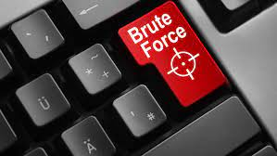
Brute-force attack on a single account:
Velocity of login attempts on the account—simple rate limiting can often be effective
Popularity rank of attempted passwords—attackers will try common passwords
Distribution of password attempts on the account—real users will attempt the same password or similar passwords

Slide 17
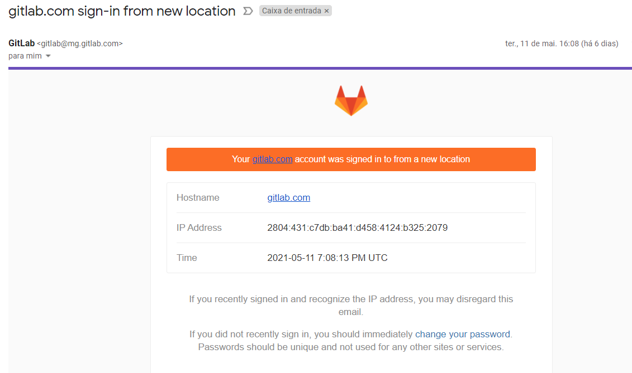
Deviation from this user’s established patterns of login
Geographic displacement from previous logins (larger distances being more suspicious)
Using a browser, app, or OS not previously used by the account
Appearing at an unusual time of day or unusual day of the week
Unusual frequency of logins or inter-login time
Unusual sequence of requests prior to login

Slide 18
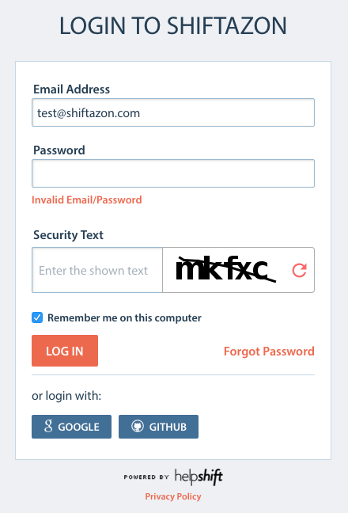
Large-scale automation of login
High volume of requests per IP address, user agent, or any other key extracted from request data
Unusually high number of invalid credentials across the site
Requests from a hosting provider or other suspicious IP addresses
Browser-based telemetry indicating nonhuman activity—e.g., keystroke timing, captcha or device-class fingerprinting

Slide 19
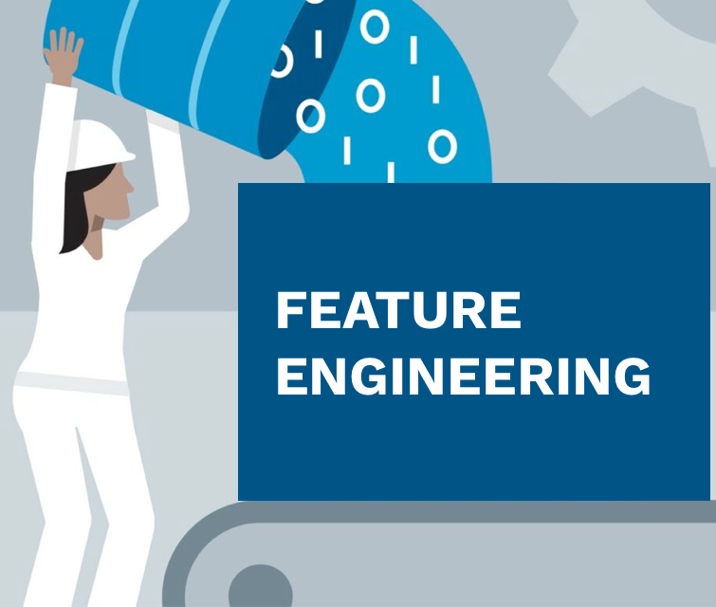
Feature Engineering
Engineering all of these features is a nontrivial task.
Labeling account compromise is an imprecise science.
Let’s assume you don’t have any labeled data. How do you use the signals described here to detect suspicious logins?

Slide 20
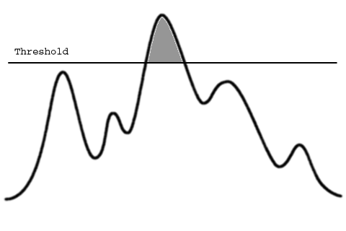
Try is to set thresholds on each of the features
For example, you could require extra verification if a user logs in more than 10 times in one hour, or more than 500 miles from any location at which they were previously observed or using an operating system they haven’t previously used.

Slide 21
Unit V – Web System Protection (1)
Outline
What is required to protect a consumer Web?
Types of Abuse - Authentication and Account Takeover (1/2)

Slide 22
Computational Intelligence (TC2023)

